Slide 1
Java/J2EE Session- 24
Concurrent Versioning System (CVS)

Slide 2
Introduction
We use CVS to maintain the multiple users accessing the same file to modify.
If there is not CVS in place we need to go to each and every person and ask whether you are working on this file or not.
If any one is working on the same file then we need to merge the code that has been done by 2 persons and then we need to finalize the code to build.
This way is a bit tricky and if there is not proper communication then there are always the chances for your code that can be overridden by some other person.

Slide 3
Introduction
The code can easily be overridden by some other person if the development team is scattered across the globe.
It would be difficult to integrate all the code that has been done by different people and send the final packaged ear file for the deployment.
To overcome the problems that we have discussed above will be solved by CVS.
CVS is just one of the software that provides the proper integration.
There are many other tools like VSS, CVS, ClearCase etc which acts as Versioning control

Slide 4
Introduction
With CVS in place we can achieve the below tasks.
  We can update our code to CVS by merging all the codes that have be developed by other developers.
  All the other developers know who all are working on the code base on a particular file.
  We can also check for the others code and update your code with the latest version.
  We can take all the latest code from CVS and package the code into an EAR file and send the build to deploy in the production.

Slide 5
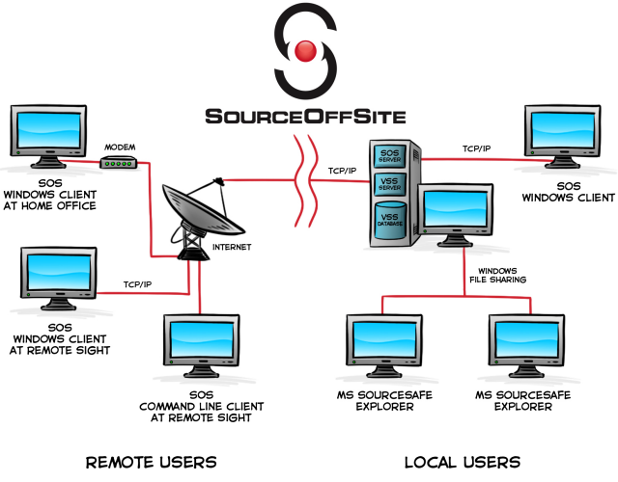
Architecture

Slide 6
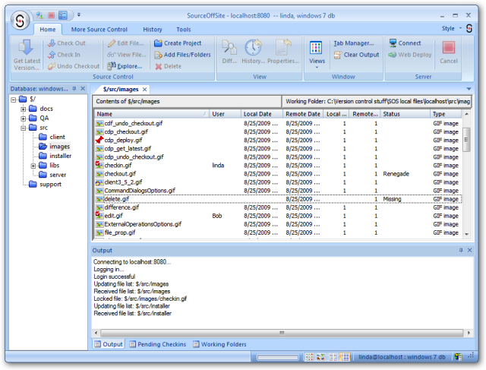
The Client Window

Slide 7
The Client Window
The Client Window that you have seen in the previous slide has 3 sections
  The Project View:
    In this project view we have all list of all the projects. For example we have a company called IBM and it is having only CVS Server and it has around 20 projects.
    All the 20 projects will be listed out in this project view
  The File List View:
    In order to this file view to populate we need to select one project from the project view.
    Once selected this view show us the list of all the file that are present in the project that you have selected.
  OutPut Window View:
    This will display the output status on the user operations like checkout, checkin and so on….

Slide 8
The File List View:
The File List on the right side of the Client window may contain as many as eight columns.
  File – The name of the file. A visual cue is also provided to show the check out and share status of the file.
  User – The name of the user who currently has the file locked.
  Local Date – The date of the local (Client) copy of the file.
  Remote Date – The date of the latest revision of the remote (Server) copy of the file in the Visual SourceSafe database.
  Local Version – The version of the local (Client) copy of the file. This is often referred to as the baseline.
  Remote Version – The latest version number of the remote (Server) copy of the file in the Visual SourceSafe database.
  Status – The status of the local copy of the file relative to the copy in the Visual SourceSafe database.
  Type – The type of file is listed based on file extension.

Slide 9
The file status
Missing –
  There is no local copy of the file. A file is determined to be Missing when the file is in the Visual SourceSafe database but not in the specified working directory on the Client machine
Old –
  The remote version of the file is newer than the local copy.
  A file is determined to be Old by comparing the version number of the file on the Client to the version number of the corresponding file in the Visual SourceSafe database.
  If the version number of the file on the Client is less than the version number of the file in the Visual SourceSafe database, the Status column displays the value of Old.

Slide 10
The file status
Edited –
  The local copy has been edited and is checked out.
  A file is determined to be Edited by comparing file modification times. When a Save command is executed on a local file, its modification time is updated to the current time.
  SourceOffSite recognizes that the time has changed so it checks whether the file is checked out by you. If the file is modified and checked out by you, then the Status column displays the value of Edited.
  The Local Date column will show the recent modification time until the file is checked in. After check in, the local time may be the modification time or check in time depending on the settings of your SourceOffSite local file options.

Slide 11
The file status
Renegade –
  The local copy has been edited but it is not checked out by you.
  A file is determined to be Renegade by comparing file modification times.
  When a Save command is executed on a local file, its modification time is updated to the current time.
  SourceOffSite recognizes that the time has changed so it checks whether the file is checked out by you.
  If the file is modified and not checked out by you, then the Status column displays the value of Renegade.
  The Local Date column is also updated with the recent modification time.

Slide 12
The file status
Unknown –
  The local copy exists but it has never been retrieved using SourceOffSite.
  A file is determined to be Unknown when SourceOffSite cannot determine which revision of the file is present locally.
  Files that exist locally because they were downloaded using Visual SourceSafe Explorer will display an Unknown status. Use the Checksums option or the Show Differences operation to see if the local and remote copies are identical.
  If the local file is not the most recent revision, use the Get Latest Version operation to retrieve the file from the database. Thereafter, the Status column will display more useful information.

Slide 13
The file status
More Recent –
  The local copy is a later version than the copy in the database. When the version number of a local file is greater than the latest version of the file in the Visual SourceSafe database, the Status column displays a value of More Recent.
  This could happen if a file is rolled back or pinned to a previous version in the database.
Needs Merge –
  The remote version of the file is newer than the local copy, and the local copy has been edited.
  Needs Merge is a combination of
  Old (there is a newer version of the file on the server) and either
  Edited (the file has been checked out and modified) or
  Renegade (the file has been modified locally but not checked out).

Slide 14
The file status
(empty) –
  If the status column is blank, then the local copy and the remote copy are identical. The local and remote copies of a file are determined to be the same by version number only. If the files share the same version number, then the Status column will display (empty). Once the file is modified in any way, the Status column will display one of the above values.

Slide 15
Basic Operations
Create Project:
  This is one of the basic operation to create a new project in CVS.
Add Files:
  Files may be added to any existing projects. Files may be added one at a time or several file can be added at a time
Delete Files:
  We can also delete the file by this operation. We can delete single file or multiple files also.
Get Latest Version:
  This operation will allow user to get the latest version that is available in the server.
  By default the files are retrieved in read-only mode.
  We can get the latest version of a single or multiple files at a time
  We can also get the latest version of the project

Slide 16
Basic Operations
CheckOut:
  The check out command enables to edit the files locally.
  The command locks the files or projects within the database.
  Once the files are checked out, the user who has the files locked is displayed in the user column of the File List.
CheckIn:
  To add the modifications to the server we need to use the operation called checkin.
  We can use this operation only on the checked out files.
  The local changes will be committed to server and other’s can see your changes only after checking in the file.

Slide 17
Basic Operations
Undo Check Out:
  We can use this operation to rollback the changes that you have done to the file after checking it out.
  Once after this operation all the local changes will be overridden by the server copy.
Show Difference
  This operation will be helpful to compare the differences between 2 different versions of the same file.
Merge:
  We use this merge operation combine 2 different files
Show History:
  Using this operation we can see the history like the version number and who has committed and what are the chagnes that have been committed to the version.

Slide 18

Questions??

